Slide 1
Cache Design

Slide 2
Who Cares About the Memory Hierarchy?
CPU-DRAM Gap
1980: no cache in µproc; 1995 2-level cache on chip
(1989 first Intel µproc with a cache on chip)
1000
µProc
60%/yr.
CPU
“Moore’s Law”
100
Processor-Memory
Performance Gap:
(grows 50% / year)
Performance
10
“Less’ Law?”
DRAM
7%/yr.
DRAM
1
1980
1981
1982
1983
1984
1985
1986
1987
1988
1989
1990
1991
1992
1993
1994
1995
1996
1997
1998
1999
2000
Notes:
Y-axis is performance
X-axis is time
Latency
Cliché:
Not e that x86 didn’t have cache on chip until 1989

Slide 3
Generations of Microprocessors
Time of a full cache miss in instructions executed:
1st Alpha: 340 ns/5.0 ns = 68 clks x 2 or 136
2nd Alpha: 266 ns/3.3 ns = 80 clks x 4 or 320
3rd Alpha: 180 ns/1.7 ns =108 clks x 6 or 648
1/2X latency x 3X clock rate x 3X Instr/clock ⇒ ­5X
Notes:
1st generation
Latency 1/2
but Clock rate 3X and IPC is 3X
Now move to other 1/2 of industry

Slide 4
Processor-Memory Performance Gap “Tax”
Processor % Area %Transistors
(­cost) (­power)
Alpha 21164 37% 77%
StrongArm SA110 61% 94%
Pentium Pro 64% 88%
  2 dies per package: Proc/I$/D$ + L2$
Caches have no “inherent value”,
only try to close performance gap
Notes:
1/3 to 2/3s of area of processor
386 had 0; successor PPro has second die!

Slide 5
What is a cache?
Small, fast storage used to improve average access time to slow memory.
Exploits spacial and temporal locality
In computer architecture, almost everything is a cache!
  Registers “a cache” on variables – software managed
  First-level cache a cache on second-level cache
  Second-level cache a cache on memory
  Memory a cache on disk (virtual memory)
  TLB a cache on page table
  Branch-prediction a cache on prediction information?
Proc/Regs
L1-Cache
Bigger
L2-Cache
Faster
Memory
Disk, Tape, etc.

Slide 6
Traditional Four Questions for Memory Hierarchy Designers
Q1: Where can a block be placed in the upper level? (Block placement)
  Fully Associative, Set Associative, Direct Mapped
Q2: How is a block found if it is in the upper level?
(Block identification)
  Tag/Block
Q3: Which block should be replaced on a miss?
(Block replacement)
  Random, LRU
Q4: What happens on a write?
(Write strategy)
  Write Back or Write Through (with Write Buffer)

Slide 7
What are all the aspects of cache organization that impact performance?

Slide 8
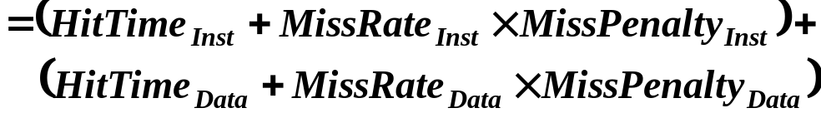
Review: Cache performance
Miss-oriented Approach to Memory Access:
  CPI_{Execution} includes ALU and Memory instructions
Separating out Memory component entirely
  AMAT = Average Memory Access Time
  CPI_{ALUOps} does not include memory instructions

Slide 9
Impact on Performance
Suppose a processor executes at
  Clock Rate = 200 MHz (5 ns per cycle), Ideal (no misses) CPI = 1.1
  50% arith/logic, 30% ld/st, 20% control
Suppose that 10% of memory operations get 50 cycle miss penalty
Suppose that 1% of instructions get same miss penalty
CPI = ideal CPI + average stalls per instruction 1.1(cycles/ins) +
[ 0.30 (DataMops/ins)
x 0.10 (miss/DataMop) x 50 (cycle/miss)] +
[ 1 (InstMop/ins)
x 0.01 (miss/InstMop) x 50 (cycle/miss)]
= (1.1 + 1.5 + .5) cycle/ins = 3.1
58% of the time the proc is stalled waiting for memory!
AMAT=(1/1.3)x[1+0.01x50]+(0.3/1.3)x[1+0.1x50]=2.54

Slide 10
Unified vs Split Caches
Unified vs Separate I&D
Example:
  16KB I&D: Inst miss rate=0.64%, Data miss rate=6.47%
  32KB unified: Aggregate miss rate=1.99%
Which is better (ignore L2 cache)?
  Assume 33% data ops ⇒ 75% accesses from instructions (1.0/1.33)
  hit time=1, miss time=50
  Note that data hit has 1 stall for unified cache (only one port)
AMAT_{Harvard}=75%x(1+0.64%x50)+25%x(1+6.47%x50) = 2.05
AMAT_{Unified}=75%x(1+1.99%x50)+25%x(1+1+1.99%x50)= 2.24
Proc
Proc
Unified
Cache-1
I-Cache-1
Proc
D-Cache-1
Unified
Cache-2
Unified
Cache-2

Slide 11
How to Improve Cache Performance?
1. Reduce the miss rate,
2. Reduce the miss penalty, or
3. Reduce the time to hit in the cache.

Slide 12
Where to misses come from?
Classifying Misses: 3 Cs
  Compulsory—The first access to a block is not in the cache, so the block must be brought into the cache. Also called cold start misses or first reference misses.
  (Misses in even an Infinite Cache)
  Capacity—If the cache cannot contain all the blocks needed during execution of a program, capacity misses will occur due to blocks being discarded and later retrieved.
  (Misses in Fully Associative Size X Cache)
  Conflict—If block-placement strategy is set associative or direct mapped, conflict misses (in addition to compulsory & capacity misses) will occur because a block can be discarded and later retrieved if too many blocks map to its set. Also called collision misses or interference misses.
  (Misses in N-way Associative, Size X Cache)
4th “C”:
  Coherence - Misses caused by cache coherence.
Notes:
Intuitive Model by Mark Hill

Slide 13
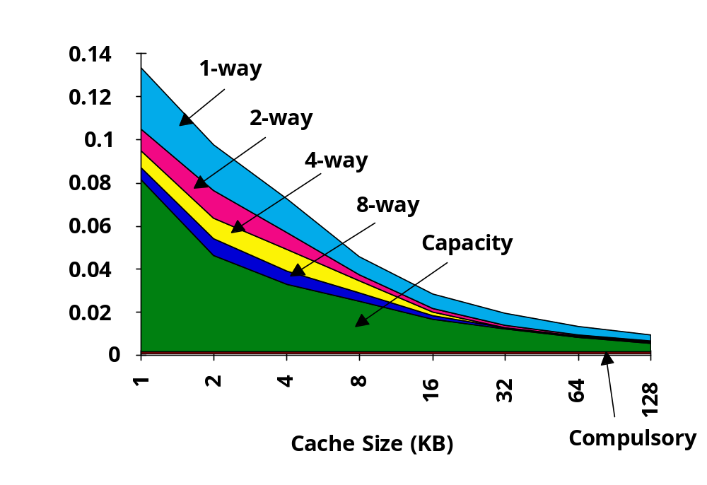
3Cs Absolute Miss Rate (SPEC92)
Conflict

Slide 14
Cache Size
Old rule of thumb: 2x size => 25% cut in miss rate
What does it reduce?

Slide 15
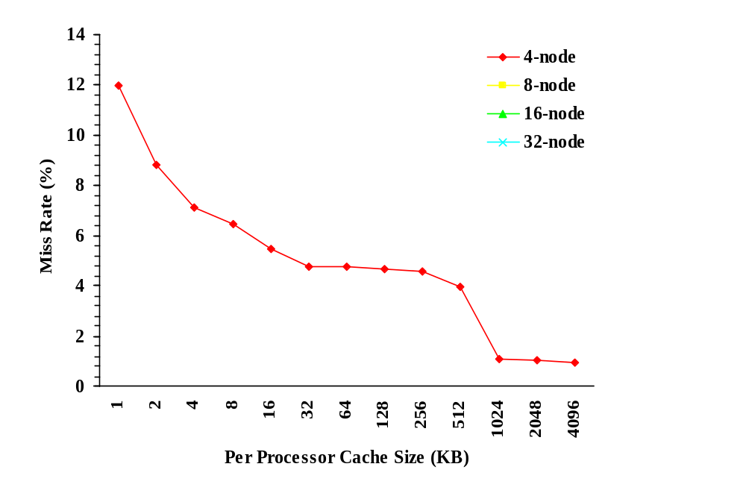
Huge Caches => Working Sets
fic
Data traf
First working set
Capacity-generated traf
fic
(including conflicts)
Second working set
Other capacity-independent communication
Inher
ent communication
Cold-start (compulsory) traf
fic
Replication capacity (cache size)
Example LU Decomposition
from NAS Parallel Benchmarks

Slide 16
Cache Organization?
Assume total cache size not changed:
What happens if:
Change Block Size:
Change Associativity:
3) Change Compiler:
Which of 3Cs is obviously affected?
Notes:
Ask which affected?
Block size
1) Compulsory
2) More subtle, will change mapping

Slide 17
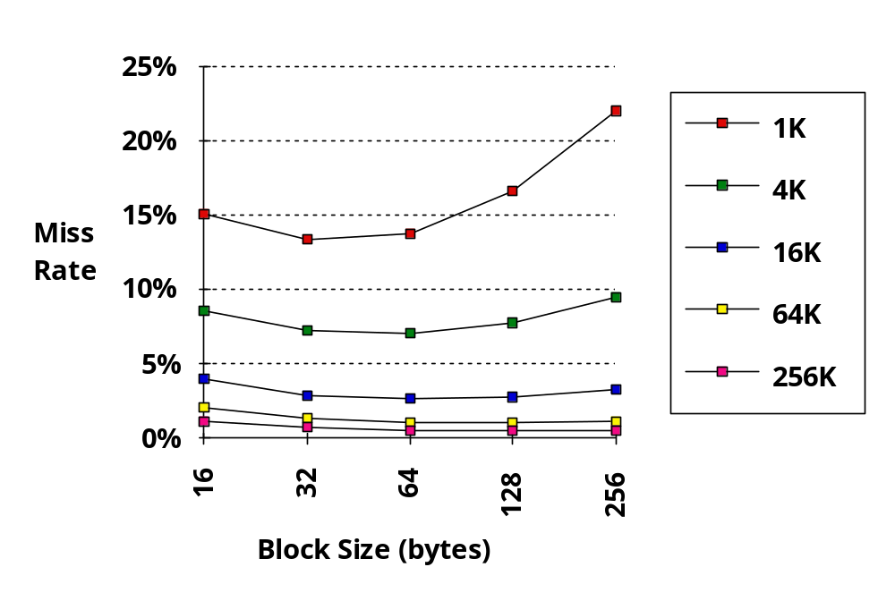
Larger Block Size
(fixed size&assoc)
Reduced
compulsory
misses
Increased
Conflict
Misses
What else drives up block size?

Slide 18
Associativity
Conflict

Slide 19
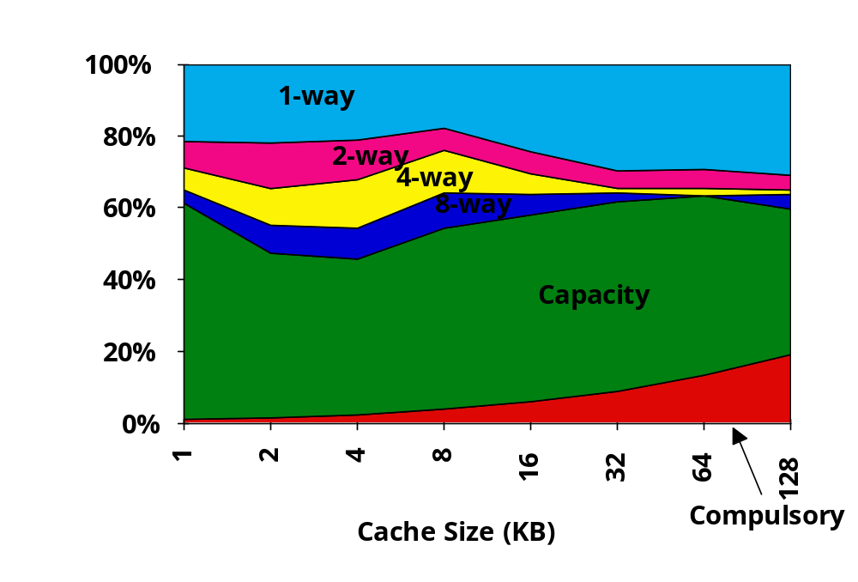
3Cs Relative Miss Rate
Conflict
Flaws: for fixed block size
Good: insight => invention

Slide 20
Associativity vs Cycle Time
Beware: Execution time is only final measure!
Why is cycle time tied to hit time?
Will Clock Cycle time increase?
  Hill [1988] suggested hit time for 2-way vs. 1-way
  external cache +10%,
  internal + 2%
  suggested big and dumb caches
Effective cycle time of assoc
pzrbski ISCA

Slide 21
Example: Avg. Memory Access Time vs. Miss Rate
Example: assume CCT = 1.10 for 2-way, 1.12 for 4-way, 1.14 for 8-way vs. CCT direct mapped
Cache Size Associativity
(KB) 1-way 2-way 4-way 8-way
1 2.33 2.15 2.07 2.01
2 1.98 1.86 1.76 1.68
4 1.72 1.67 1.61 1.53
8 1.46 1.48 1.47 1.43
16 1.29 1.32 1.32 1.32
32 1.20 1.24 1.25 1.27
64 1.14 1.20 1.21 1.23
128 1.10 1.17 1.18 1.20
(Red means A.M.A.T. not improved by more associativity)

Slide 22
Fast Hit Time + Low Conflict => Victim Cache
How to combine fast hit time of direct mapped
yet still avoid conflict misses?
Add buffer to place data discarded from cache
Jouppi [1990]: 4-entry victim cache removed 20% to 95% of conflicts for a 4 KB direct mapped data cache
Used in Alpha, HP machines
TAGS
DATA
Tag and Comparator
One Cache line of Data
Tag and Comparator
One Cache line of Data
Tag and Comparator
One Cache line of Data
Tag and Comparator
One Cache line of Data
To Next Lower Level In
Hierarchy

Slide 23
Reducing Misses via
“Pseudo-Associativity”
How to combine fast hit time of Direct Mapped and have the lower conflict misses of 2-way SA cache?
Divide cache: on a miss, check other half of cache to see if there, if so have a pseudo-hit (slow hit)
Drawback: CPU pipeline is hard if hit takes 1 or 2 cycles
  Better for caches not tied directly to processor (L2)
  Used in MIPS R1000 L2 cache, similar in UltraSPARC
Hit Time
Pseudo Hit Time
Miss Penalty
Time

Slide 24
Reducing Misses by Hardware Prefetching of Instructions & Data
E.g., Instruction Prefetching
  Alpha 21064 fetches 2 blocks on a miss
  Extra block placed in “stream buffer”
  On miss check stream buffer
Works with data blocks too:
  Jouppi [1990] 1 data stream buffer got 25% misses from 4KB cache; 4 streams got 43%
  Palacharla & Kessler [1994] for scientific programs for 8 streams got 50% to 70% of misses from
  2 64KB, 4-way set associative caches
Prefetching relies on having extra memory bandwidth that can be used without penalty

Slide 25
Reducing Misses by
Software Prefetching Data
Data Prefetch
  Load data into register (HP PA-RISC loads)
  Cache Prefetch: load into cache (MIPS IV, PowerPC, SPARC v. 9)
  Special prefetching instructions cannot cause faults; a form of speculative execution
Prefetching comes in two flavors:
  Binding prefetch: Requests load directly into register.
    Must be correct address and register!
  Non-Binding prefetch: Load into cache.
    Can be incorrect. Faults?
Issuing Prefetch Instructions takes time
  Is cost of prefetch issues < savings in reduced misses?
  Higher superscalar reduces difficulty of issue bandwidth

Slide 26
Reducing Misses by Compiler Optimizations
McFarling [1989] reduced caches misses by 75%
on 8KB direct mapped cache, 4 byte blocks in software
Instructions
  Reorder procedures in memory so as to reduce conflict misses
  Profiling to look at conflicts(using tools they developed)
Data
  Merging Arrays: improve spatial locality by single array of compound elements vs. 2 arrays
  Loop Interchange: change nesting of loops to access data in order stored in memory
  Loop Fusion: Combine 2 independent loops that have same looping and some variables overlap
  Blocking: Improve temporal locality by accessing “blocks” of data repeatedly vs. going down whole columns or rows

Slide 27
Merging Arrays Example
/* Before: 2 sequential arrays */
int val[SIZE];
int key[SIZE];
/* After: 1 array of stuctures */
struct merge {
int val;
int key;
};
struct merge merged_array[SIZE];
Reducing conflicts between val & key;
improve spatial locality

Slide 28
Loop Interchange Example
/* Before */
for (k = 0; k < 100; k = k+1)
for (j = 0; j < 100; j = j+1)
for (i = 0; i < 5000; i = i+1)
x[i][j] = 2 * x[i][j];
/* After */
for (k = 0; k < 100; k = k+1)
for (i = 0; i < 5000; i = i+1)
for (j = 0; j < 100; j = j+1)
x[i][j] = 2 * x[i][j];
Sequential accesses instead of striding through memory every 100 words; improved spatial locality

Slide 29
Loop Fusion Example
/* Before */
for (i = 0; i < N; i = i+1)
for (j = 0; j < N; j = j+1)
a[i][j] = 1/b[i][j] * c[i][j];
for (i = 0; i < N; i = i+1)
for (j = 0; j < N; j = j+1)
d[i][j] = a[i][j] + c[i][j];
/* After */
for (i = 0; i < N; i = i+1)
for (j = 0; j < N; j = j+1)
{ a[i][j] = 1/b[i][j] * c[i][j];
d[i][j] = a[i][j] + c[i][j];}
2 misses per access to a & c vs. one miss per access; improve spatial locality

Slide 30
Blocking Example
/* Before */
for (i = 0; i < N; i = i+1)
for (j = 0; j < N; j = j+1)
{r = 0;
for (k = 0; k < N; k = k+1){
r = r + y[i][k]*z[k][j];};
x[i][j] = r;
};
Two Inner Loops:
  Read all NxN elements of z[]
  Read N elements of 1 row of y[] repeatedly
  Write N elements of 1 row of x[]
Capacity Misses a function of N & Cache Size:
  2N³ + N² => (assuming no conflict; otherwise …)
Idea: compute on BxB submatrix that fits

Slide 31
Blocking Example
/* After */
for (jj = 0; jj < N; jj = jj+B)
for (kk = 0; kk < N; kk = kk+B)
for (i = 0; i < N; i = i+1)
for (j = jj; j < min(jj+B-1,N); j = j+1)
{r = 0;
for (k = kk; k < min(kk+B-1,N); k = k+1) {
r = r + y[i][k]*z[k][j];};
x[i][j] = x[i][j] + r;
};
B called Blocking Factor
Capacity Misses from 2N³ + N² to N³/B+2N²
Conflict Misses Too?

Slide 32
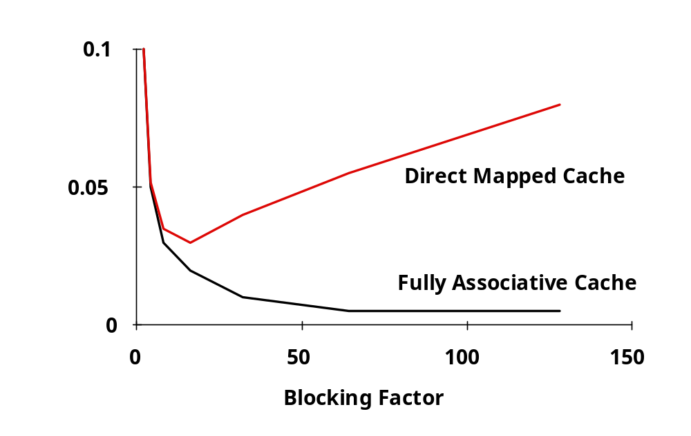
Reducing Conflict Misses by Blocking
Conflict misses in caches not FA vs. Blocking size
  Lam et al [1991] a blocking factor of 24 had a fifth the misses vs. 48 despite both fit in cache

Slide 33
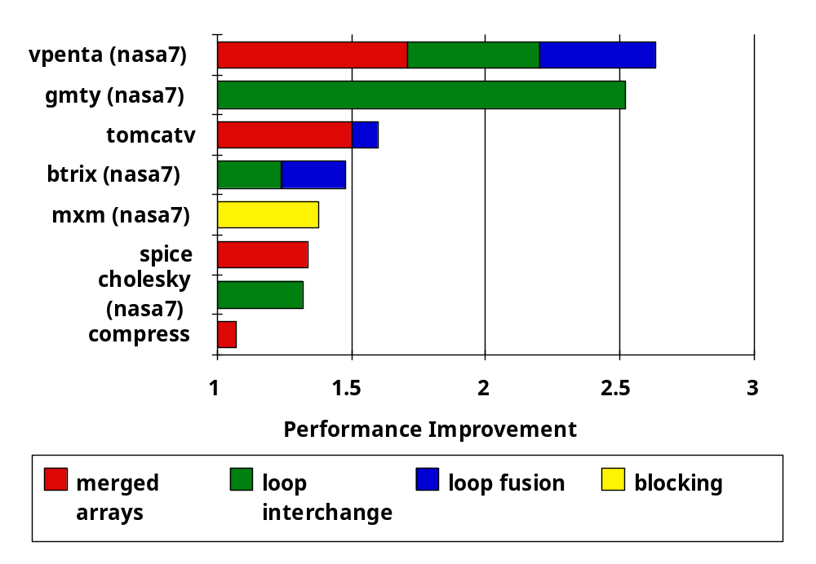
Summary of Compiler Optimizations to Reduce Cache Misses (by hand)

Slide 34
Summary: Miss Rate Reduction
3 Cs: Compulsory, Capacity, Conflict
  0. Larger cache
  1. Reduce Misses via Larger Block Size
  2. Reduce Misses via Higher Associativity
  3. Reducing Misses via Victim Cache
  4. Reducing Misses via Pseudo-Associativity
  5. Reducing Misses by HW Prefetching Instr, Data
  6. Reducing Misses by SW Prefetching Data
  7. Reducing Misses by Compiler Optimizations
Prefetching comes in two flavors:
  Binding prefetch: Requests load directly into register.
    Must be correct address and register!
  Non-Binding prefetch: Load into cache.
    Can be incorrect. Frees HW/SW to guess!

Slide 35
Review: Improving Cache Performance
1. Reduce the miss rate,
2. Reduce the miss penalty, or
3. Reduce the time to hit in the cache.

Slide 36
Write Policy:
Write-Through vs Write-Back
Write-through: all writes update cache and underlying memory/cache
  Can always discard cached data - most up-to-date data is in memory
  Cache control bit: only a valid bit
Write-back: all writes simply update cache
  Can’t just discard cached data - may have to write it back to memory
  Cache control bits: both valid and dirty bits
Other Advantages:
  Write-through:
    memory (or other processors) always have latest data
    Simpler management of cache
  Write-back:
    much lower bandwidth, since data often overwritten multiple times
    Better tolerance to long-latency memory?

Slide 37
Write Policy 2:
Write Allocate vs Non-Allocate
(What happens on write-miss)
Write allocate: allocate new cache line in cache
  Usually means that you have to do a “read miss” to fill in rest of the cache-line!
  Alternative: per/word valid bits
Write non-allocate (or “write-around”):
  Simply send write data through to underlying memory/cache - don’t allocate new cache line!

Slide 38
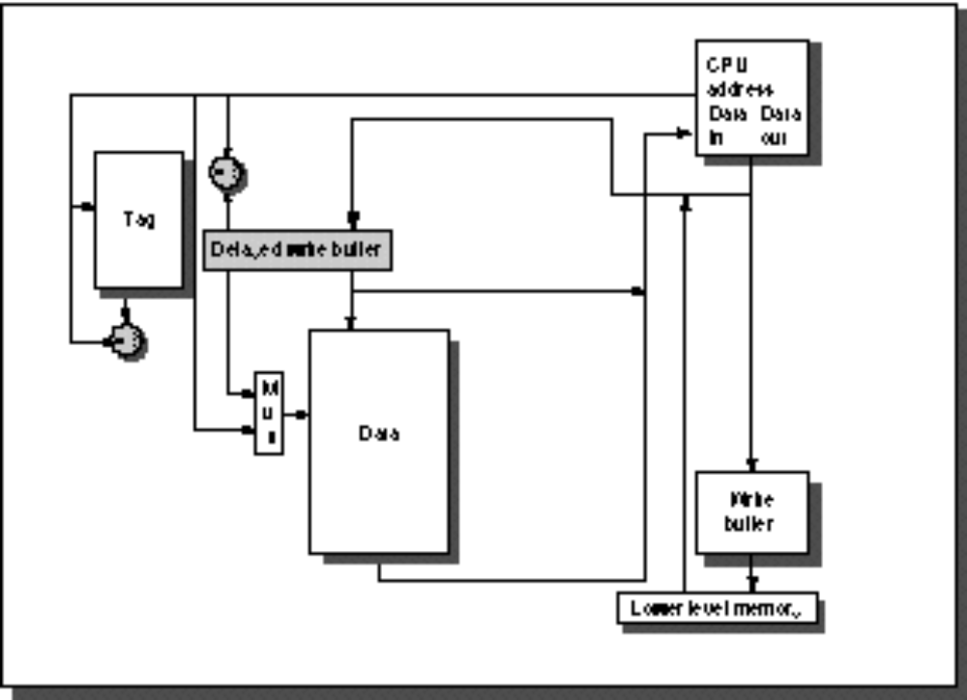
1. Reducing Miss Penalty:
Read Priority over Write on Miss
CPU
in out
Write Buffer
write
buffer
DRAM
(or lower mem)

Slide 39
1. Reducing Miss Penalty:
Read Priority over Write on Miss
Write-through w/ write buffers => RAW conflicts with main memory reads on cache misses
  If simply wait for write buffer to empty, might increase read miss penalty (old MIPS 1000 by 50% )
  Check write buffer contents before read;
  if no conflicts, let the memory access continue
Write-back want buffer to hold displaced blocks
  Read miss replacing dirty block
  Normal: Write dirty block to memory, and then do the read
  Instead copy the dirty block to a write buffer, then do the read, and then do the write
  CPU stall less since restarts as soon as do read

Slide 40
2. Reduce Miss Penalty:
Early Restart and Critical Word First
Don’t wait for full block to be loaded before restarting CPU
  Early restart—As soon as the requested word of the block ar_x001f_rives, send it to the CPU and let the CPU continue execution
  Critical Word First—Request the missed word first from memory and send it to the CPU as soon as it arrives; let the CPU continue execution while filling the rest of the words in the block. Also called wrapped fetch and requested word first
Generally useful only in large blocks,
Spatial locality => tend to want next sequential word, so not clear if benefit by early restart
block

Slide 41
3. Reduce Miss Penalty: Non-blocking Caches to reduce stalls on misses
Non-blocking cache or lockup-free cache allow data cache to continue to supply cache hits during a miss
  requires F/E bits on registers or out-of-order execution
  requires multi-bank memories
“hit under miss” reduces the effective miss penalty by working during miss vs. ignoring CPU requests
“hit under multiple miss” or “miss under miss” may further lower the effective miss penalty by overlapping multiple misses
  Significantly increases the complexity of the cache controller as there can be multiple outstanding memory accesses
  Requires muliple memory banks (otherwise cannot support)
  Penium Pro allows 4 outstanding memory misses

Slide 42
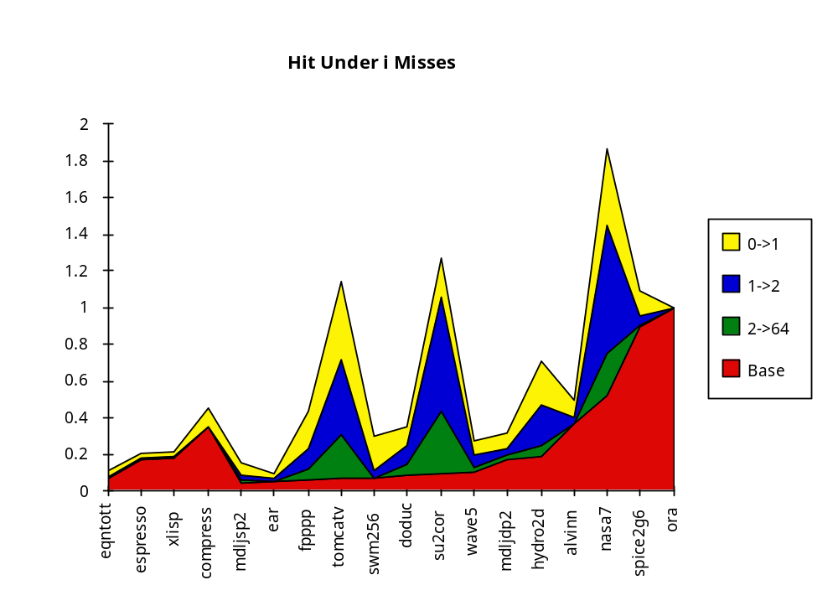
Value of Hit Under Miss for SPEC
0->1
1->2
2->64
Base
“Hit under n Misses”
Integer
Floating Point
FP programs on average: AMAT= 0.68 -> 0.52 -> 0.34 -> 0.26
Int programs on average: AMAT= 0.24 -> 0.20 -> 0.19 -> 0.19
8 KB Data Cache, Direct Mapped, 32B block, 16 cycle miss

Slide 43
4: Add a second-level cache
L2 Equations
AMAT = Hit Time_{L1} + Miss Rate_{L1} x Miss Penalty_{L1}
Miss Penalty_{L1} = Hit Time_{L2} + Miss Rate_{L2} x Miss Penalty_{L2}
AMAT = Hit Time_{L1} +
Miss Rate_{L1} x (Hit Time_{L2} + Miss Rate_{L2} + Miss Penalty_{L2})
Definitions:
  Local miss rate— misses in this cache divided by the total number of memory accesses to this cache (Miss rate_{L2})
  Global miss rate—misses in this cache divided by the total number of memory accesses generated by the CPU
  Global Miss Rate is what matters

Slide 44
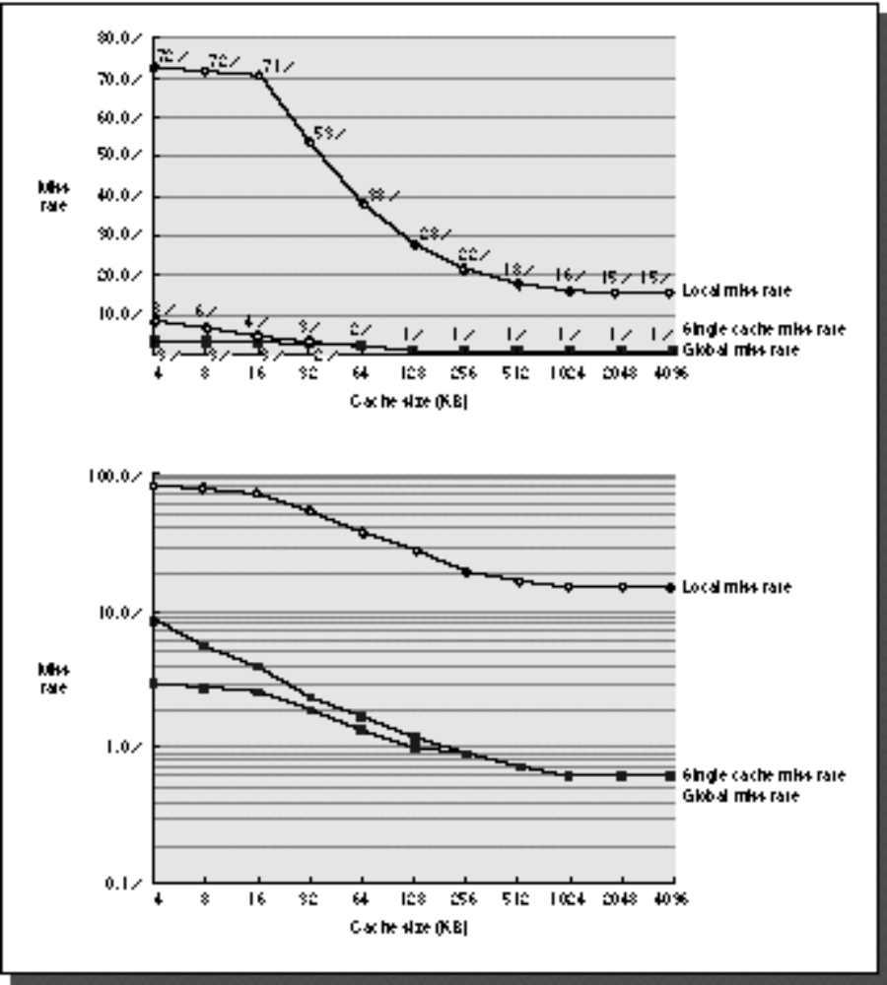
Comparing Local and Global Miss Rates
32 KByte 1st level cache;
Increasing 2nd level cache
Global miss rate close to single level cache rate provided L2 >> L1
Don’t use local miss rate
L2 not tied to CPU clock cycle!
Cost & A.M.A.T.
Generally Fast Hit Times and fewer misses
Since hits are few, target miss reduction
Linear
Cache Size
Log
Cache Size

Slide 45
Reducing Misses:
Which apply to L2 Cache?
Reducing Miss Rate
  1. Reduce Misses via Larger Block Size
  2. Reduce Conflict Misses via Higher Associativity
  3. Reducing Conflict Misses via Victim Cache
  4. Reducing Conflict Misses via Pseudo-Associativity
  5. Reducing Misses by HW Prefetching Instr, Data
  6. Reducing Misses by SW Prefetching Data
  7. Reducing Capacity/Conf. Misses by Compiler Optimizations

Slide 46
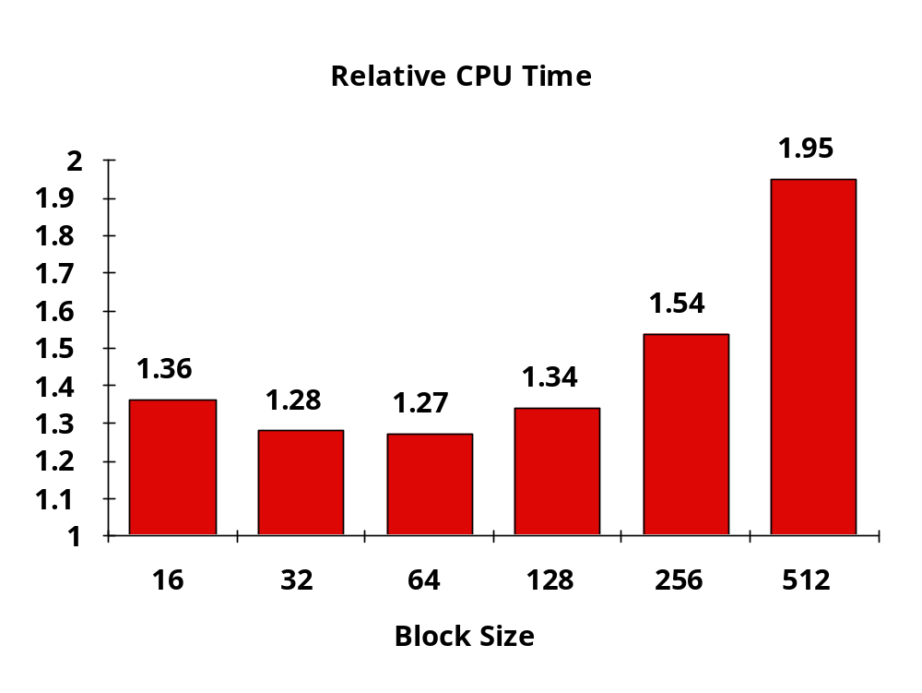
L2 cache block size & A.M.A.T.
32KB L1, 8 byte path to memory

Slide 47
Reducing Miss Penalty Summary
Four techniques
  Read priority over write on miss
  Early Restart and Critical Word First on miss
  Non-blocking Caches (Hit under Miss, Miss under Miss)
  Second Level Cache
Can be applied recursively to Multilevel Caches
  Danger is that time to DRAM will grow with multiple levels in between
  First attempts at L2 caches can make things worse, since increased worst case is worse

Slide 48
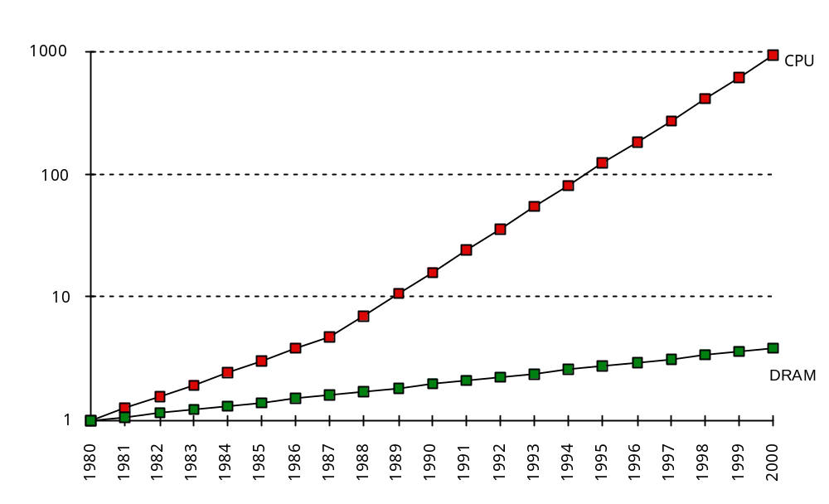
What is the Impact of What You’ve Learned About Caches?
1960-1985: Speed
= ƒ(no. operations)
1990
  Pipelined
  Execution &
  Fast Clock Rate
  Out-of-Order
  execution
  Superscalar
  Instruction Issue
1998: Speed =
ƒ(non-cached memory accesses)
Superscalar, Out-of-Order machines hide L1 data cache miss
(­5 clocks) but not L2 cache miss (­50 clocks)?

Slide 49
Cache Optimization Summary
Technique MR MP HT Complexity
Larger Block Size + – 0
Higher Associativity + – 1
Victim Caches + 2
Pseudo-Associative Caches + 2
HW Prefetching of Instr/Data + 2
Compiler Controlled Prefetching + 3
Compiler Reduce Misses + 0
Priority to Read Misses + 1
Early Restart & Critical Word 1st + 2
Non-Blocking Caches + 3
Second Level Caches + 2
miss rate
miss penalty

